Slide 1
Research Communication Skills
Referencing and creating a reference list

Slide 2
Intended Learning Outcomes
By the end of this lesson you will be able to:
  distinguish which information should be referenced and which should not
  distinguish between quotations and paraphrasing
  give examples of referencing conventions
  distinguish between different referencing systems
  write a reference list

Slide 3
Referencing

Slide 4
Why Reference?
Reader’s benefit
  To understand the context of your work
  To allow your reader to track down your research
Your benefit
  To show off!
  To add authority to your argument
  To add credibility to your information

Slide 5
Why Reference?
Ethical reasons:
Intellectual integrity
To distinguish between:
  Your ideas
  Someone else’s ideas
Intellectual property issues

Slide 6
What should be referenced?
Ideas, information, results, opinions from any source that you have summarised, paraphrased or directly quoted
Definitions of terms
Illustrations, tables, figures drawn from sources
Your ideas that are also those of an author you have read
Plans, ideas or anything that was stimulated by others

Slide 7
Guiding principles
Respect the
  Creation of ideas by others
  Concept of intellectual property
Acknowledge the ideas of others
But,
Don’t reference “common knowledge”

Slide 8
What is common knowledge?
A general rule of thumb:
  If you didn’t know it before you read the research, then it is not common knowledge and you need to reference it.
  If most classmates would know it then it probably is common knowledge.

Slide 9
HOW does one reference accurately
Many conventions
Vary – university, country, even school and subject area

Slide 10
Guidance from:
Faculty, school or subject guides
Software such as RefWorks, EndNote
Websites devoted to referencing!
Articles you read

Slide 11
Academic writing needs:
References in the text
PLUS
References in a list at the end of your work

Slide 12
Common requirements of all conventions
References in the text
  Acknowledge within the text
  Acknowledge closely as possible to the point
References in a list at the end of your work
  Include all sources referred to in a list at the end of your paper
    This list is usually called a Reference List
    Sometimes called List of Works Consulted or Bibliography
  Include all details about the sources in your list

Slide 13
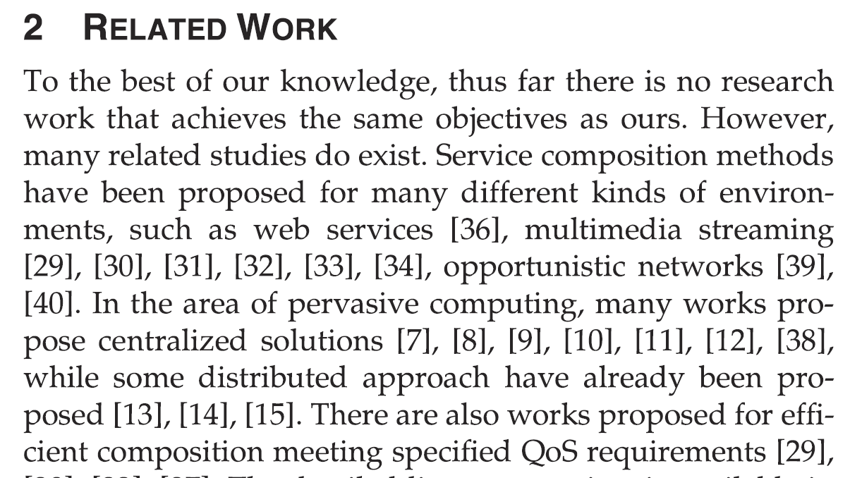
References in the text

Slide 14
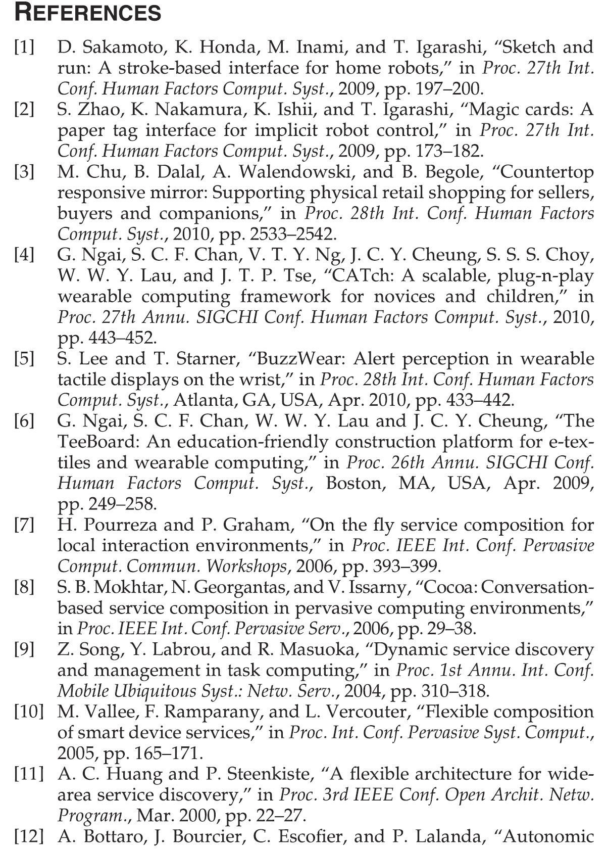
References in a list at the end of your work

Slide 15
Basic referencing systems: in the text
Author and date
  Harvard, APA, MLA (later versions)
Numbering which links to footnotes or endnotes
  Oxford, Chicago
Numbering which links to the reference list
  Vancouver

Slide 16
Is anything missing in the following text?
Think different
systems
The literature review begins with a scrutiny of the various definitions of a smart city presented by Fernandez-Anez. Arasteh et al. discuss the relationship between IoT and a smart city, while Luong et al. survey the economic and pricing theory and their applications in data collection and communication for IoT. Da Silva et al. survey the architecture for smart cities, while El Baz and Bourgeois discuss the architecture of a specific smart city application (Logistic Mobile Application).

Slide 17
Is anything missing in the following text?
Think different
systems
The literature review begins with a scrutiny of the various definitions of a smart city presented by Fernandez-Anez. Arasteh et al. discuss the relationship between IoT and a smart city, while Luong et al. survey the economic and pricing theory and their applications in data collection and communication for IoT. Da Silva et al. survey the architecture for smart cities, while El Baz and Bourgeois discuss the architecture of a specific smart city application (Logistic Mobile Application).

Slide 18
Missing?
Mention of the authors’ names not sufficient. For reference to be complete:
Author-date system must include years of publication of the research cited.
If numerical referencing system is being used, the numbers of the references must be added.

Slide 19
Is anything missing in the following text?
The literature review begins with a scrutiny of the various definitions of a smart city presented by Fernandez-Anez [4]. Arasteh et al. [8] discuss the relationship between IoT and a smart city, while Luong et al. [9] survey the economic and pricing theory and their applications in data collection and communication for IoT. Da Silva et al. [10] survey the architecture for smart cities, while El Baz and Bourgeois [11] discuss the architecture of a specific smart city application (Logistic Mobile Application).

Slide 20
Compiling the Reference List

Slide 21


Slide 22
Exercise

Slide 23
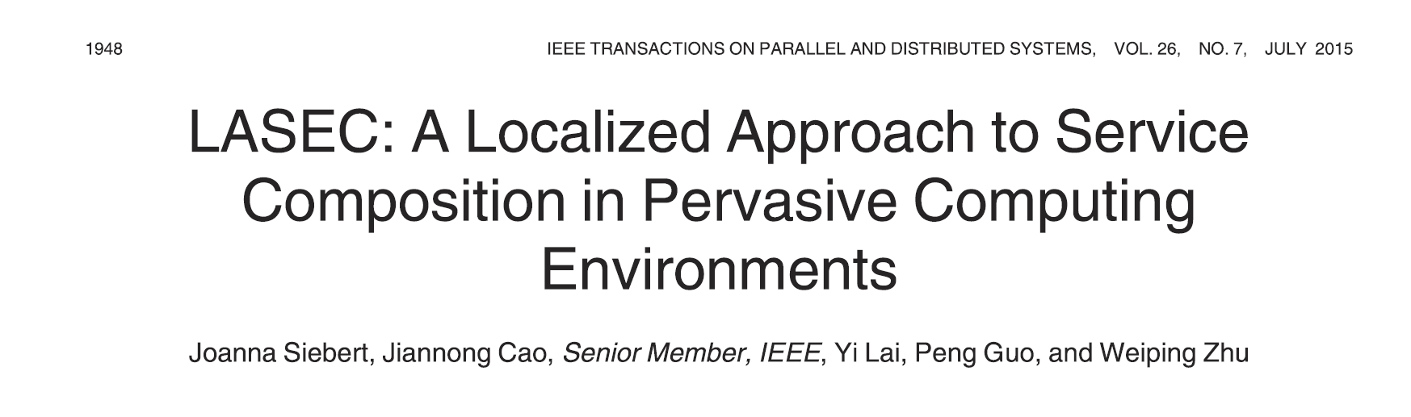

Write a reference to this paper:
Using this template:

Slide 24
IEEE
J. Siebert, J. Cao, Y. Lai, P. Guo and W. Zhu, "LASEC: A localized approach to service composition in pervasive computing environments", IEEE Trans. Parallel Distrib. Syst., vol. 26, no. 7, pp. 1948-1957, Jul. 2015.

Slide 25
MLA
Siebert, J. et al. “LASEC: A Localized Approach to Service Composition in Pervasive Computing Environments.” IEEE Transactions on Parallel and Distributed Systems 26 (2015): 1948-1957.

Slide 26
APA
Siebert, J., Cao, J., Lai, Y., Guo, P., & Zhu, W. (2015). LASEC: A Localized Approach to Service Composition in Pervasive Computing Environments. IEEE Transactions on Parallel and Distributed Systems, 26, 1948-1957.

Slide 27
CHICAGO
Siebert, J., Jiannong Cao, Yi Lai, Peng Guo and Weiping Zhu. “LASEC: A Localized Approach to Service Composition in Pervasive Computing Environments.” IEEE Transactions on Parallel and Distributed Systems 26 (2015): 1948-1957.

Slide 28
Vancouver
Siebert J, Cao J, Lai Y, Guo P, Zhu W. LASEC: A Localized Approach to Service Composition in Pervasive Computing Environments. IEEE Transactions on Parallel and Distributed Systems. 2015 Jul 1;26(7):1948-1957. 6846304. doi: 10.1109/TPDS.2014.2331052

Slide 29
Necessary Information
Names of authors (family names and at least initials)
Name of journal article, chapter or conference paper
Name of journal, book, conference, etc.
Date of publication
Volume number (for journals)
Editor of book (if applicable)
Publisher (for books)
Place of publication (for books)
Page numbers (of article or book chapter )

Slide 30
Basic Referencing Systems: Reference Lists
Alphabetical
Sources appear alphabetically according to the family name of the first author – this is the most common system.
  Burnett, T.E.D.
  Wishart, Jennifer

Slide 31
Basic Referencing Systems: Reference Lists
Numerical (eg. Vancouver)
Sources are listed
  numerically by order of their first citation in the text
  by the family name of the first author
  in other words, each source is given a number that it retains throughout the work.

Slide 32
Using footnotes
In the text there will be:
  a number next to the reference
At the bottom (foot) of the page there will be:
  The same number + name of author, date and details about the publication
  Sometimes a comment by the author
Footnote systems list sources used at the end of the work

Slide 33
In-text references to websites
  Use author and publication date or latest update
  Unknown author?
    Treat organisation as author
  Organisation unknown?
    Use title of the web page as author
  Site not dated?
    use ‘n.d.’ for ‘no date’
  In reference list include date you accessed the site as well as author, date, title of website and url.

Slide 34
Summary
Know which system is required
When recording ideas from readings, record all the bibliographic details
Always take note of the page number
Distinguish between information from the source, and your own thinking
Be consistent!
Follow the rules implicitly (don’t question why the system wants a colon and not a comma – just do it!)
Check referencing before submitting

